Slide 1

Merit Badges
And
Blue Cards

Slide 2
Merit Badges – What, Why and Where?
Merit Badges are awards earned by members of the Boy Scouts of America, based on activities within the area of study by completing a list of periodically updated requirements
Merit badges exist to encourage Scouts to explore areas that interest them and to teach them valuable skills in Scoutcraft. The award of merit badges sometimes leads to careers and lifelong hobbies.
https://www.scouting.org/programs/scouts-bsa/advancement-and-awards/merit-badges/

Slide 3
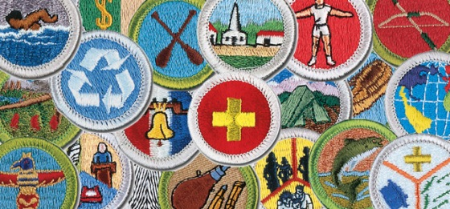
Merit Badges – Eagle Required vs. Not?
A total of 21 merit badges (10 more than required for the Life rank) must be earned for the Eagle Scout rank, including these 13 merit badges:
First Aid
Citizenship in the Community
Citizenship in the Nation
Citizenship in the World
Communication
Cooking
Personal Fitness
Environmental Science OR Sustainability
Personal Management
Swimming OR Hiking OR Cycling
Camping
Family Life

Slide 4
How do I start a Merit Badge?
Pick a subject that interests you
https://www.scouting.org/programs/scouts-bsa/advancement-and-awards/merit-badges/
Discuss with your family
Discuss with your Patrol/Troop
Discuss with SM/ASM
Open up a Merit Badge with the Advancement Chair
Attend a Merit Badge Day
Troop Sponsored Events
CPC Sponsored Events
Evergreen Aviation Museum
Online Merit Badge Courses
Cabela’s Merit Badge Days

Slide 5
What can I expect to do for a Merit Badge?
For the Blue Card
Get a Blue Card
Fill it out
Get it signed by the SM
Contact MBC
Do the work
Get it signed by the MBC
Get it signed by the SM
Turn it in
In General
Be Safe
Observe YPT – Youth Protection
Do, Show, Explain, Demonstrate, Tell, Research etc… are all examples of the essence of a requirement, what ever is stated is what is required
Keep track of your Blue Card
Keep track of your MBC
Requirements do change – usually a grace period of 1 year

Slide 6
Merit Badge Success – Resources and Organization
Stay Organized
Notebook / 3 Ring Binder
Card Collecting Inserts
Use Worksheets
Not for turning in
Good for remembering
http://usscouts.org/usscouts/meritbadges.asp
https://boyscouttrail.com/boy-scouts/meritbadges/
Covid-19 Detail
Ensure Troopmaster Record
Take pictures after progress
Identify and use resources effectively
People
Family
Troop staff and other adults
Council staff
Community members
Places/Things
Library
Online resources
https://www.scouting.org/coronavirus/covid-19-faq/

Slide 7
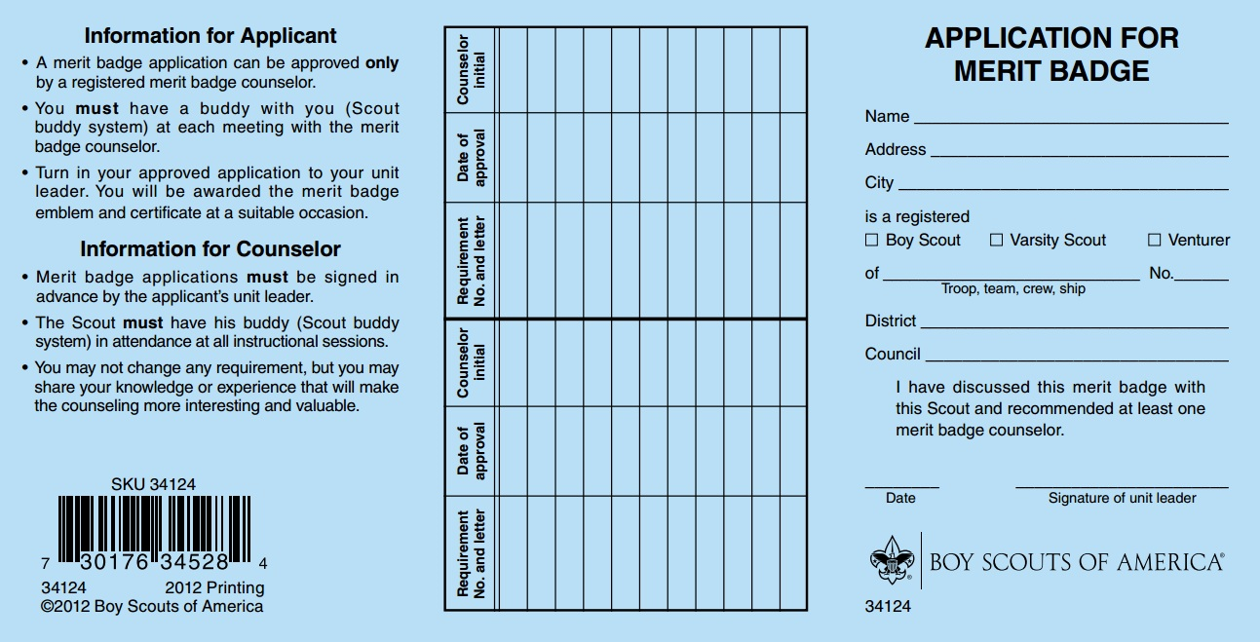
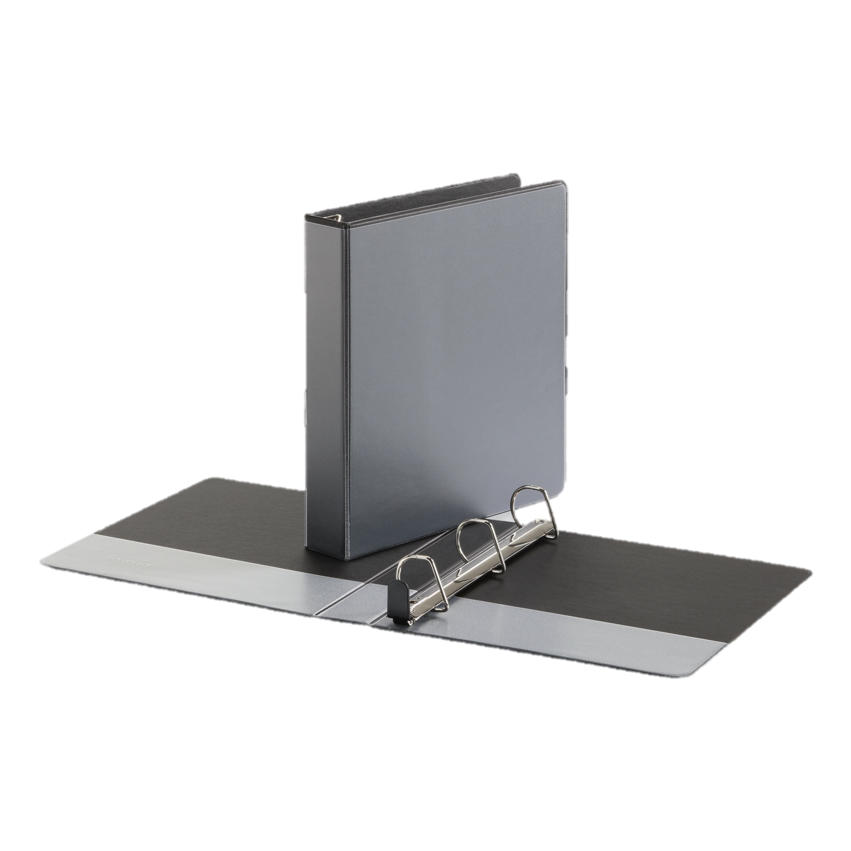
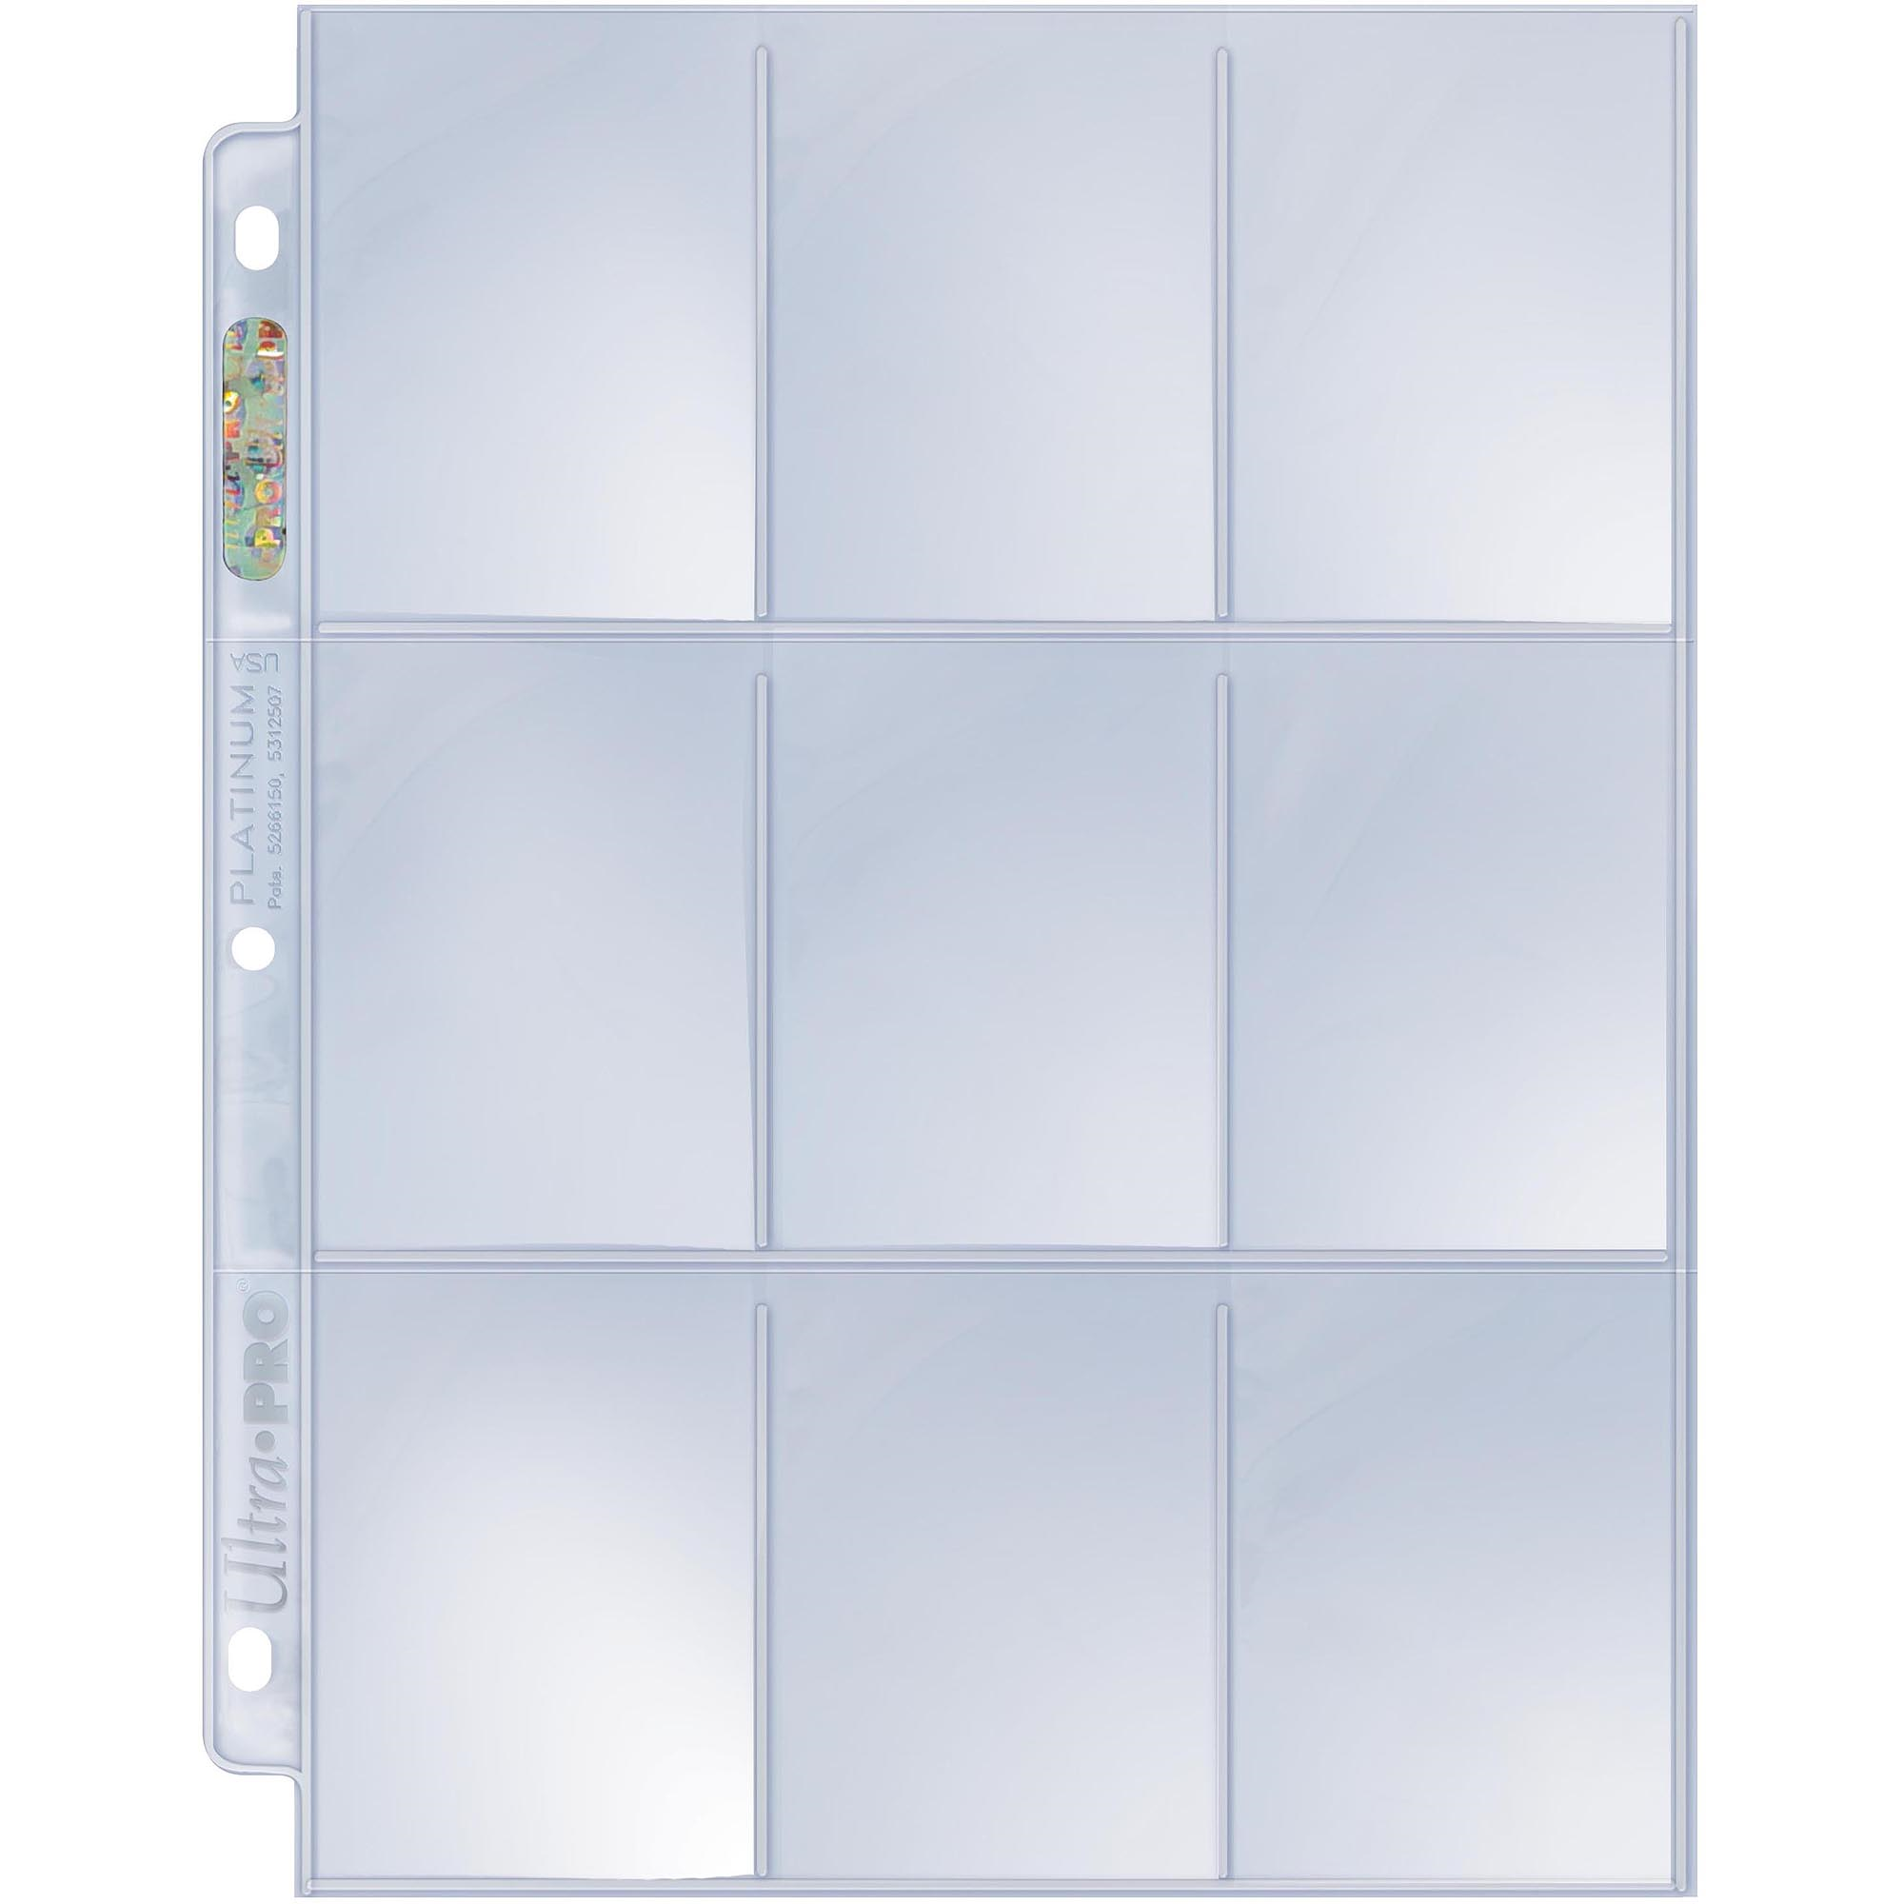
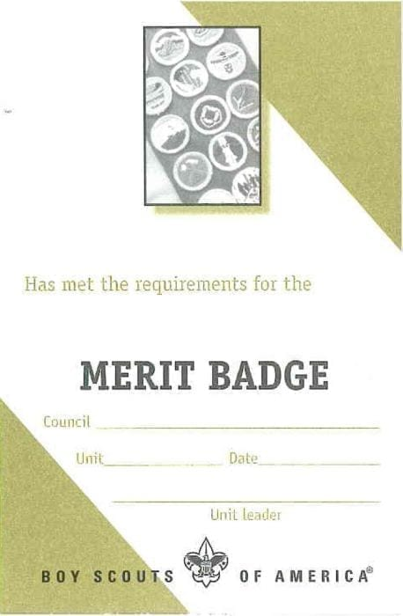
Use 3 Ring Binder with Collecting Inserts

Slide 8
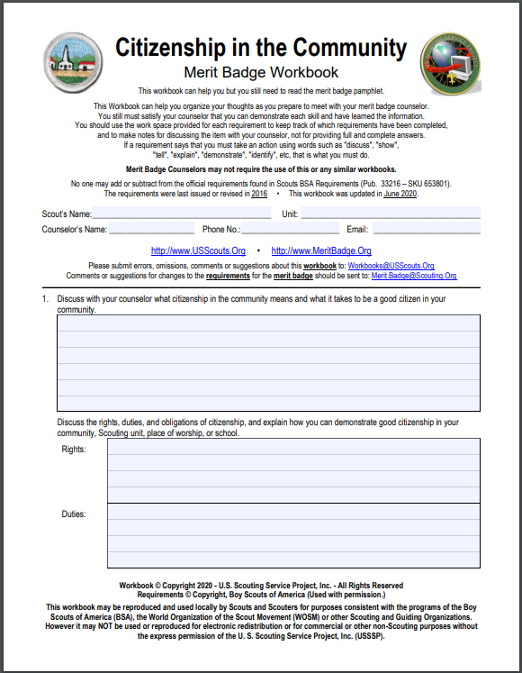
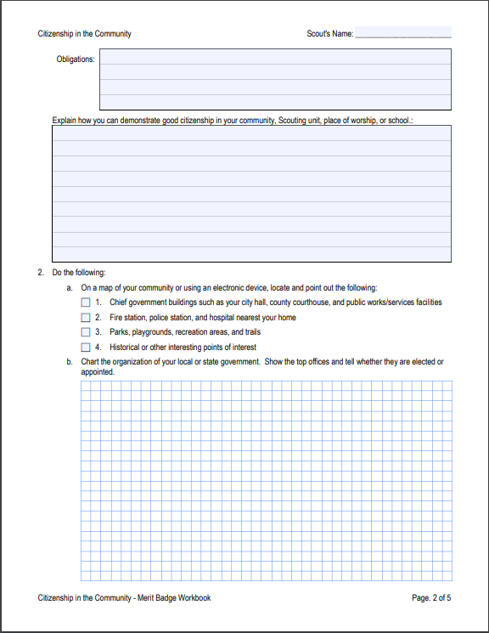
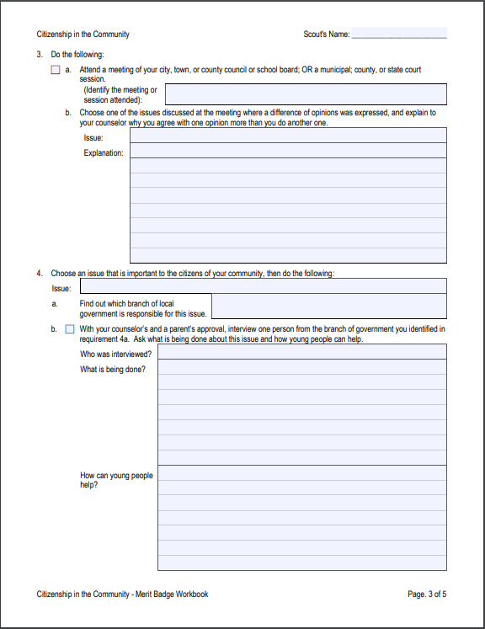
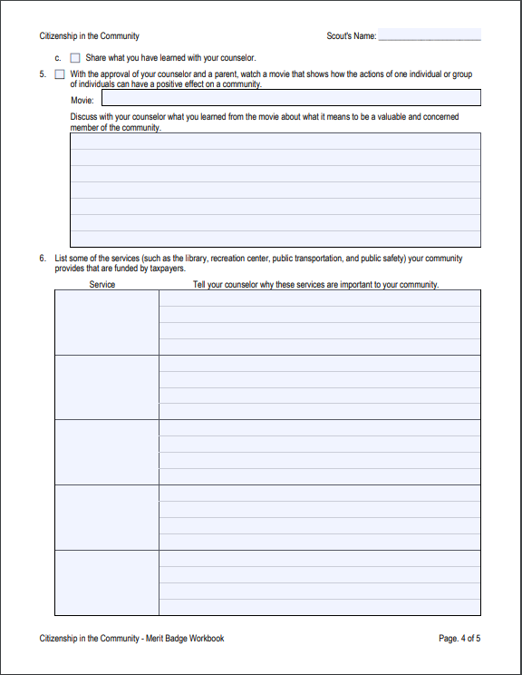
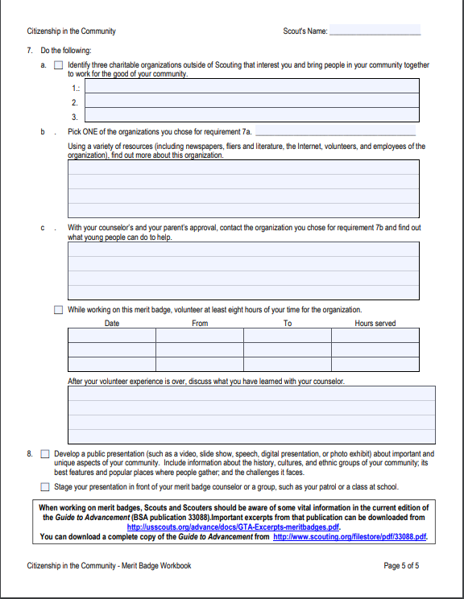
http://usscouts.org/mb/worksheets/citizenship-in-the-community.pdf

Slide 9
What is a Troop Library?
A collection of books and other documents related to scouting
Leadership
Organization
Skits
Songs
Maps
Manuals
Other items…
Merit Badge Books!
Contact your Troop Librarian today!

Slide 10
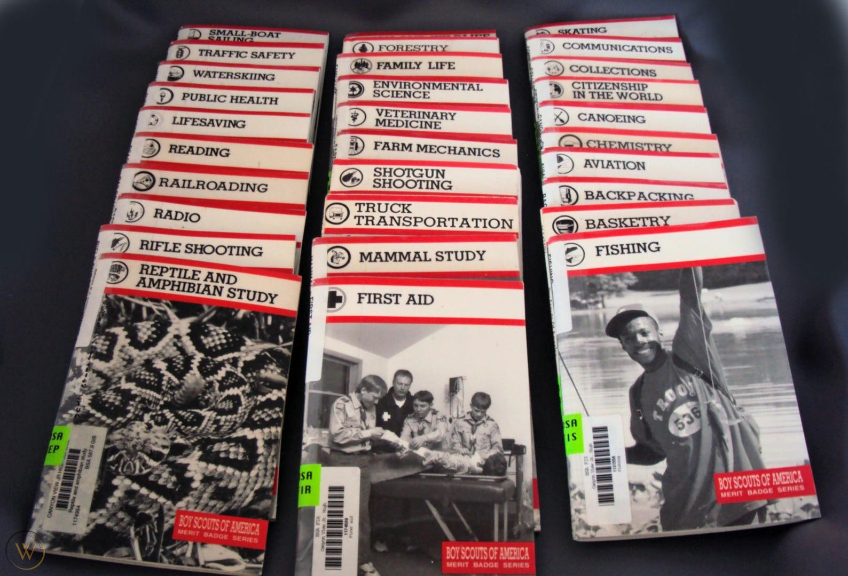

What is a Merit Badge Book?
What they used to look like
What they look like now

Slide 11

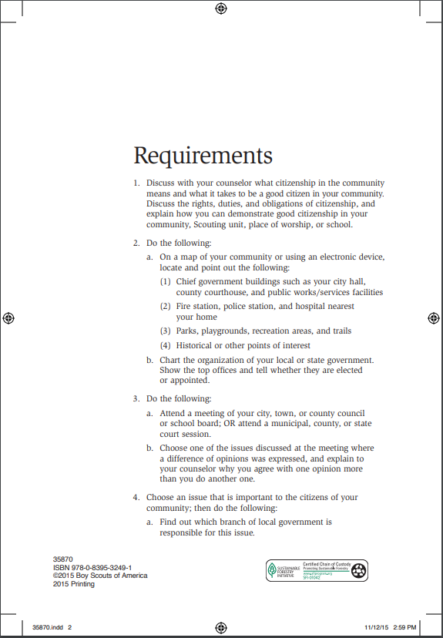
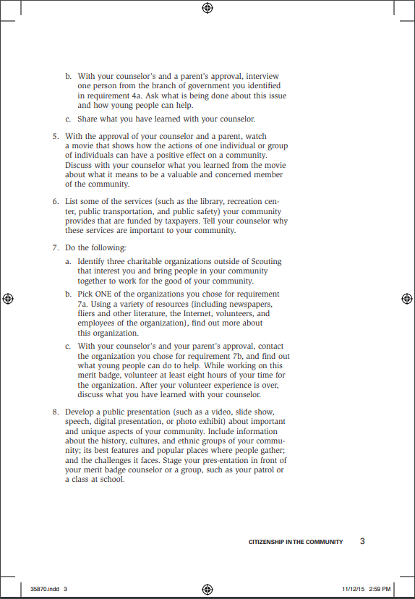
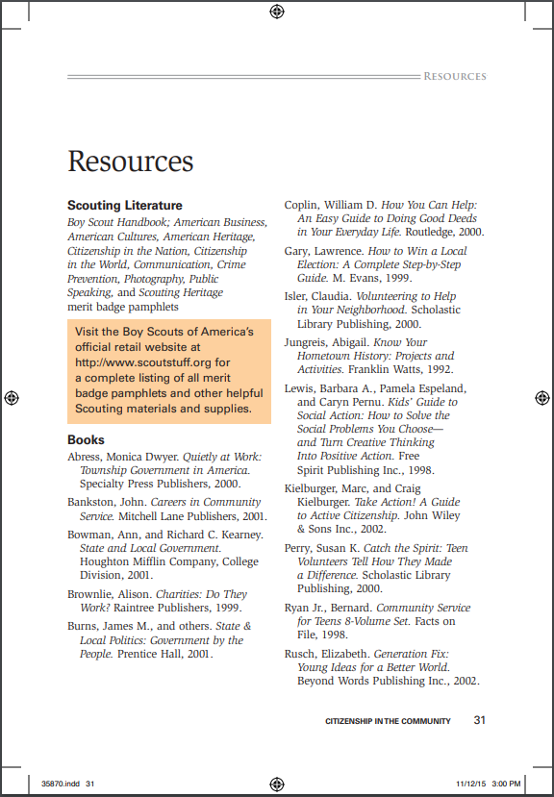
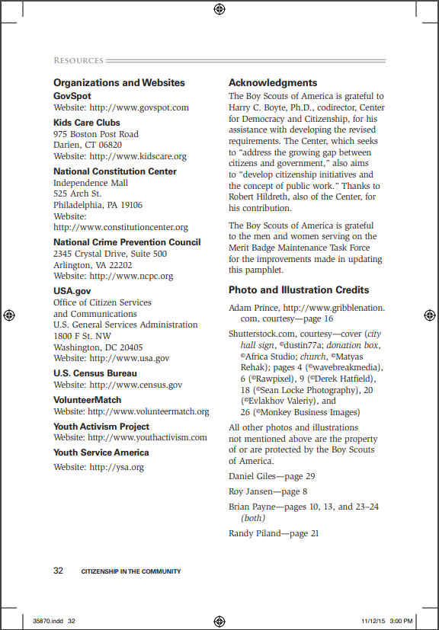

https://filestore.scouting.org/filestore/Merit_Badge_ReqandRes/Citizenship_in_the_Community.pdf

Slide 12
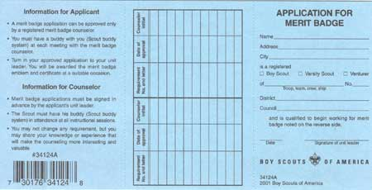
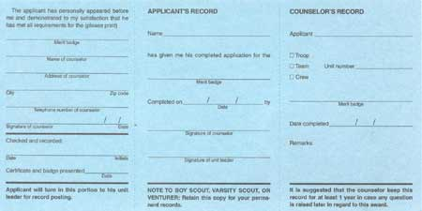
Blue Card – Front
Blue Card – Back

Slide 13
Blue Card – Front
Name
Order and Role
1.
Advancement Chair
Merit Badge Name
Blue Card – Back
Name of Counselor
Contact
Information

Slide 14
Blue Card – Front
Name
Order and Role
1.
Date
SM Signature
Advancement Chair
2.
Scoutmaster
Merit Badge Name
Blue Card – Back
Name of Counselor
Contact
Information

Slide 15
Blue Card – Front
Name
Address
City
Boy Scout/Troop 116
Sasquatch
Cascade Pacific
Order and Role
1.
Date
SM Signature
Advancement Chair
2.
Scoutmaster
3.
Applicant
Merit Badge Name
Name
Name
Blue Card – Back
Name of Counselor
Boy Scout/Troop 116
Merit Badge Name
Contact
Information
Merit Badge Name

Slide 16
Make Contact with your MBC!
You own this relationship!
You will keep track of your own records
You will communicate and drive schedules/meetings/progress
You will ensure you get signed off for items completed
If not completed, discuss what is outstanding from the requirement

Slide 17
Blue Card – Front
Name
Address
City
Boy Scout/Troop 116
Sasquatch
Cascade Pacific
Track Progress
Requirement
Date
Initials
Order and Role
1.
Date
SM Signature
Advancement Chair
2.
Scoutmaster
3.
Applicant
4.
MBC
Merit Badge Name
Name
Name
Blue Card – Back
Name of Counselor
Boy Scout/Troop 116
Merit Badge Name
Contact
Information
Merit Badge Name

Slide 18
Blue Card – Front
Name
Address
City
Boy Scout/Troop 116
Sasquatch
Cascade Pacific
Track Progress
Requirement
Date
Initials
Order and Role
1.
Date
SM Signature
Advancement Chair
2.
Scoutmaster
3.
Applicant
4.
MBC
Merit Badge Name
Name
Name
Blue Card – Back
5.
MBC
Name of Counselor
Boy Scout/Troop 116
Merit Badge Name
Contact
Information
Date
Merit Badge Name
MBC Signature
Date

Slide 19
Blue Card – Front
Name
Address
City
Boy Scout/Troop 116
Sasquatch
Cascade Pacific
Track Progress
Requirement
Date
Initials
Order and Role
1.
Date
SM Signature
Advancement Chair
2.
Scoutmaster
3.
Applicant
4.
MBC
Merit Badge Name
Name
Name
Blue Card – Back
5.
MBC
Name of Counselor
Boy Scout/Troop 116
Merit Badge Name
Scoutmaster
Contact
Information
6.
Date
Merit Badge Name
MBC Signature
Date
SM Signature

Slide 20
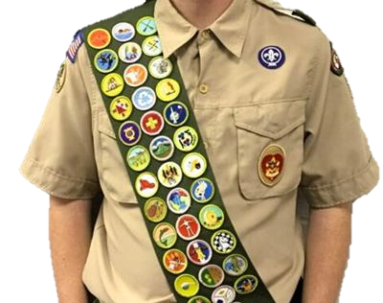
I finished my Merit Badge, now what?
Keep your portion of the Blue Card
Go to the Court of Honor
Keep the card that came with the Merit Badge
Put the Merit Badge on your Sash
Wear your Sash with pride

Slide 21
Thank
You!

